Slide 1
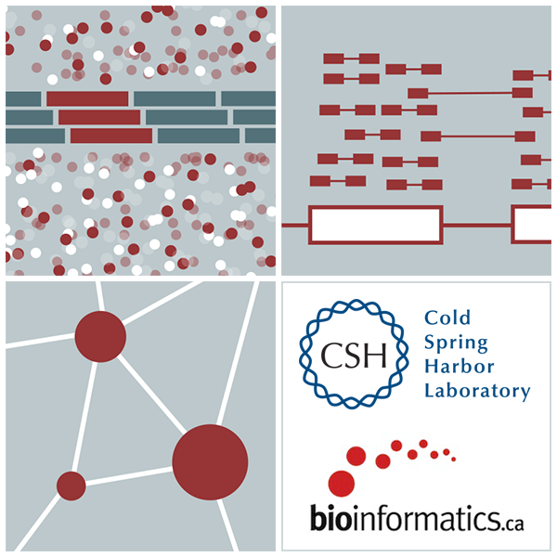
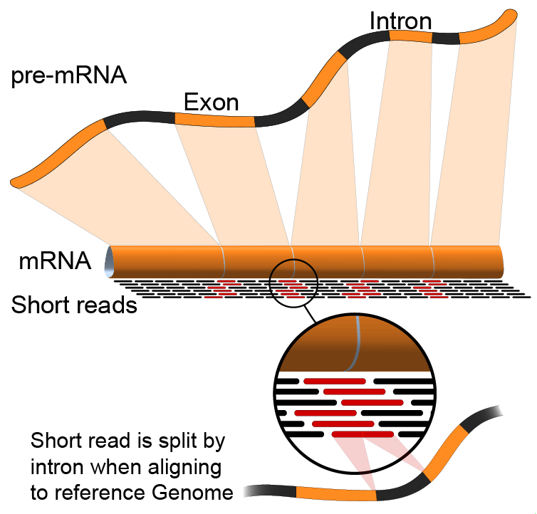

Advanced analyses in scRNAseq and multi-omic integration
Kelsy Cotto, Malachi Griffith, Obi Griffith, Evelyn Schmidt, Kartik Singhal, Zach Skidmore
CRI Bioinformatics Workshop. May 17-22, 2025

Slide 2
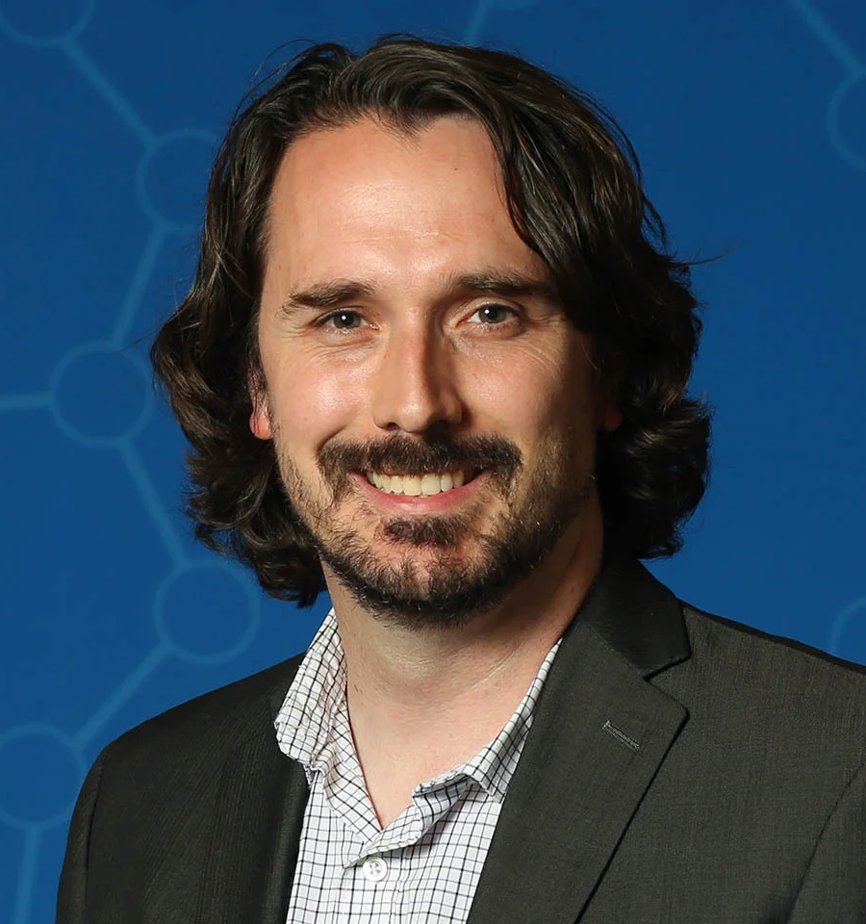
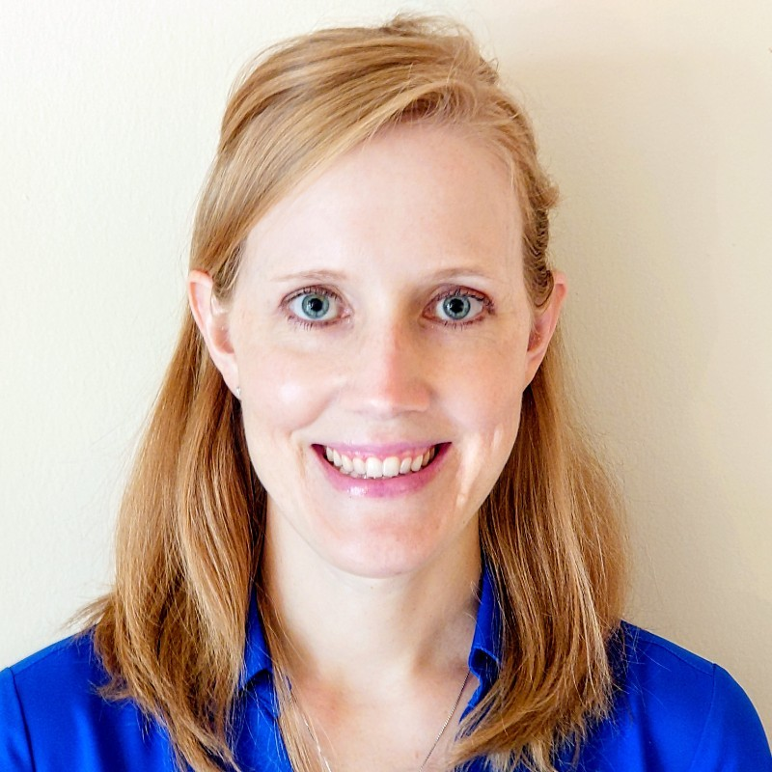


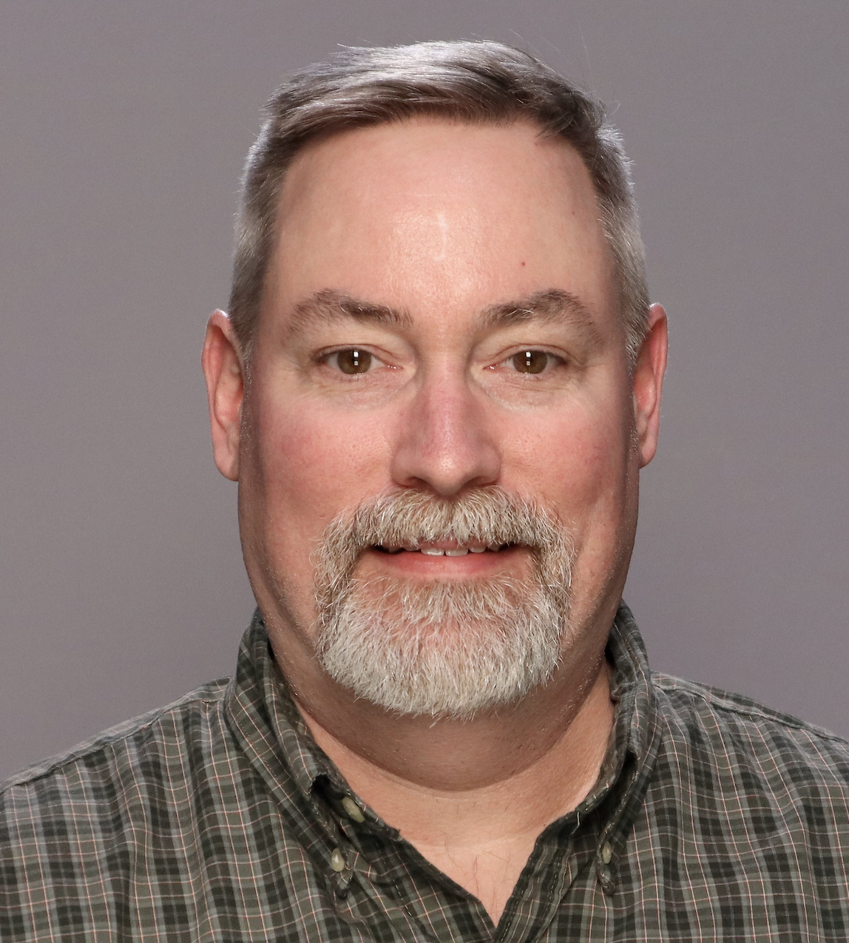
Acknowledgements
Jon Preall, CSHL, SEQTEC
Jennifer Foltz, Washington University, Genomics in Medicine
Trevor Pugh, PMH, OICR, CBW
Allegra Petti, MGH/Harvard
Brian Haas, Broad Institute

Slide 3
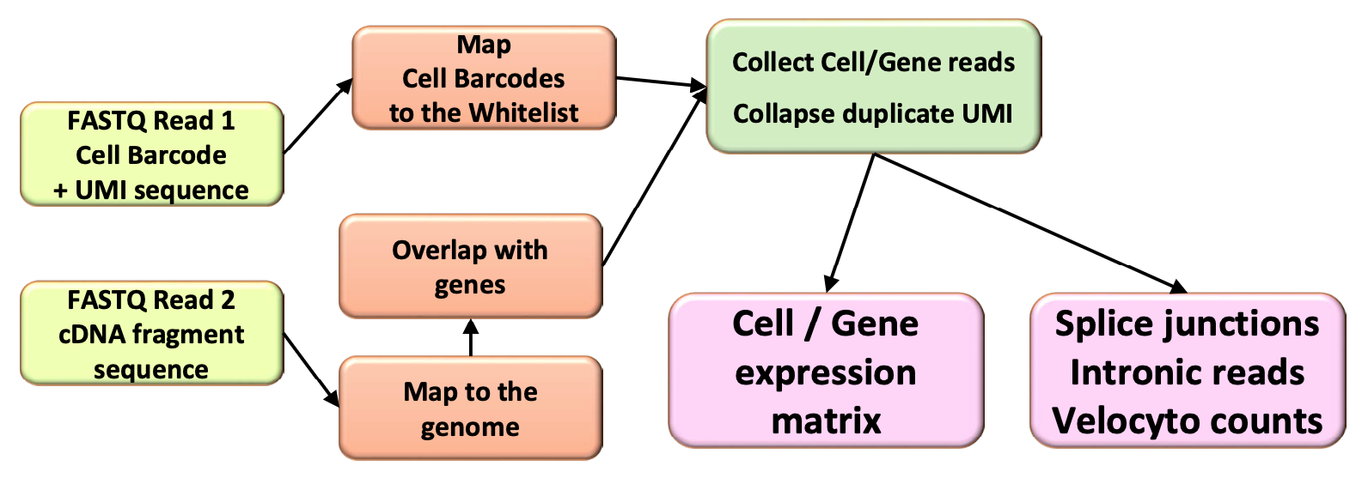
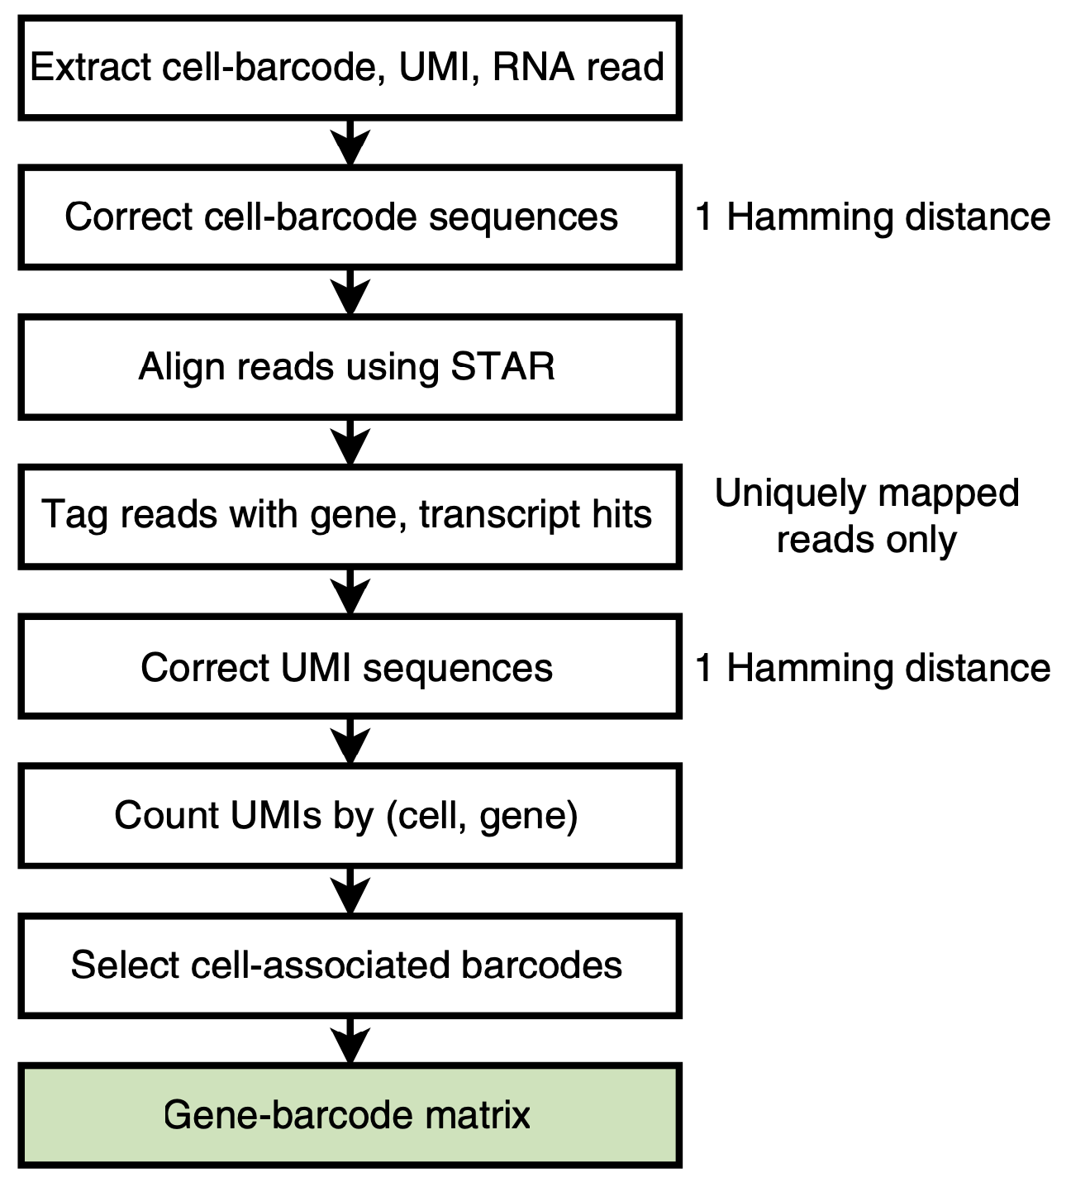
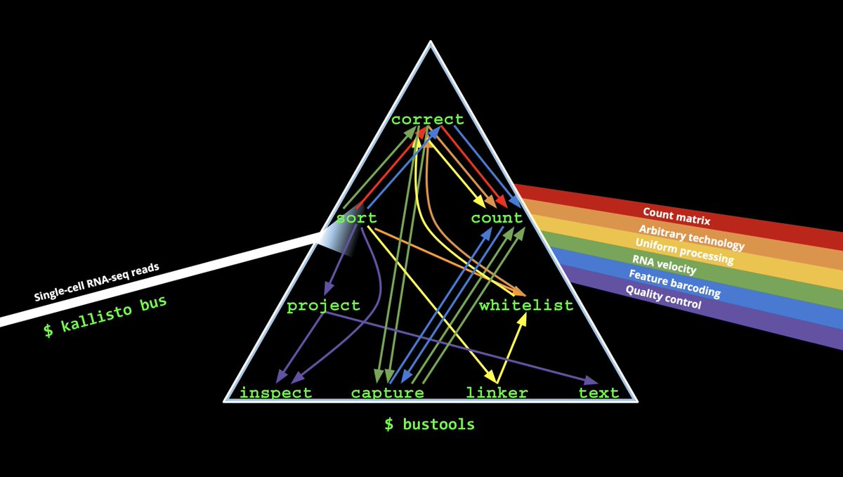
scRNA tools (primary analysis)
StarSolo
kallisto/
bustools
Cell Ranger

Slide 4
Mapping and Counting
Secondary Analysis
Extract Cell Barcode, UMI, Feature read
Calculate QC metrics
Correct Cell Barcodes
1 hamming distance
Predict doublets
Align to reference with STAR
Filter cells (dead, doublets, outliers)
Assign reads to genes with GTF file
Unique mappers
Normalize & transform (i.e. log)
Cellranger / STARsolo / etc
Feature selection (eg. HVG)
UMI correction
1 hamming distance
Seurat / Scanpy / Liger etc.
Linear Regression
Collapse UMIs, tally genes/cells
Zero-center & Scale
Raw Gene/Cell Matrix
PCA (Linear Dim. Reduc)
Filter empty droplets, keep cells
(EmptyDrops)
Neighbor Graph
Filtered Gene/Cell Matrix
Clustering (Leiden)
tSNE / UMAP
Differential Expression

Slide 5
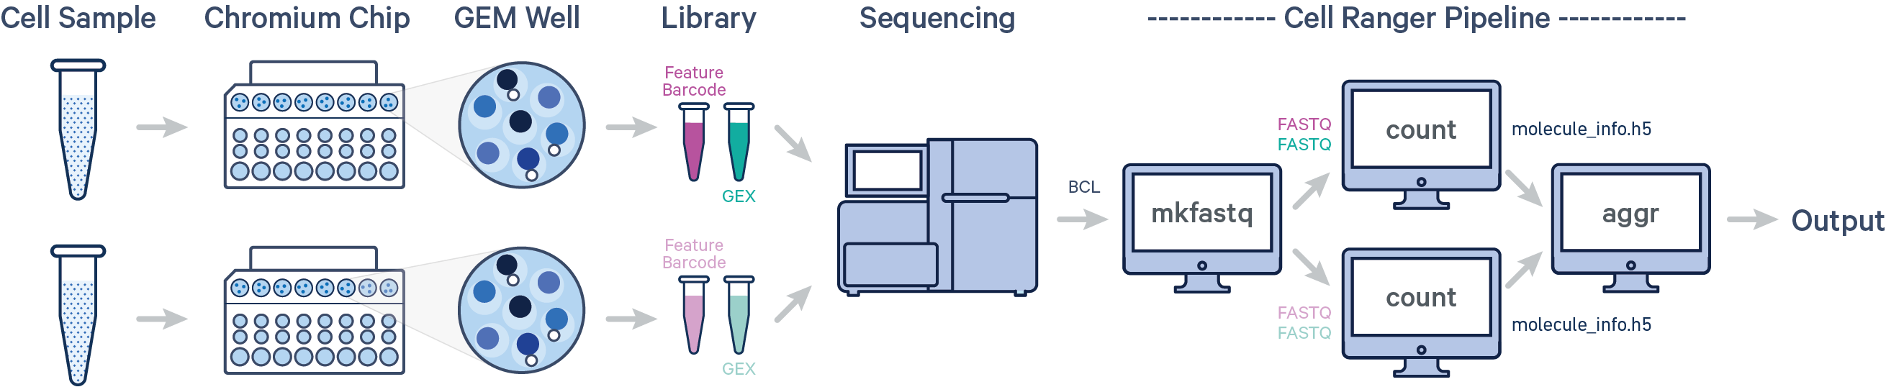
10X Genomics Cell Ranger
Support page: https://support.10xgenomics.com/single-cell-gene-expression/software/pipelines/latest/what-is-cell-ranger
Option 1: Use 10X Genomics Cloud
credits included with reagent purchase
Option 2: Install and run on Linux system:
a. local mode (single computer)
b. cluster mode
Probably run by sequence provider

Slide 6
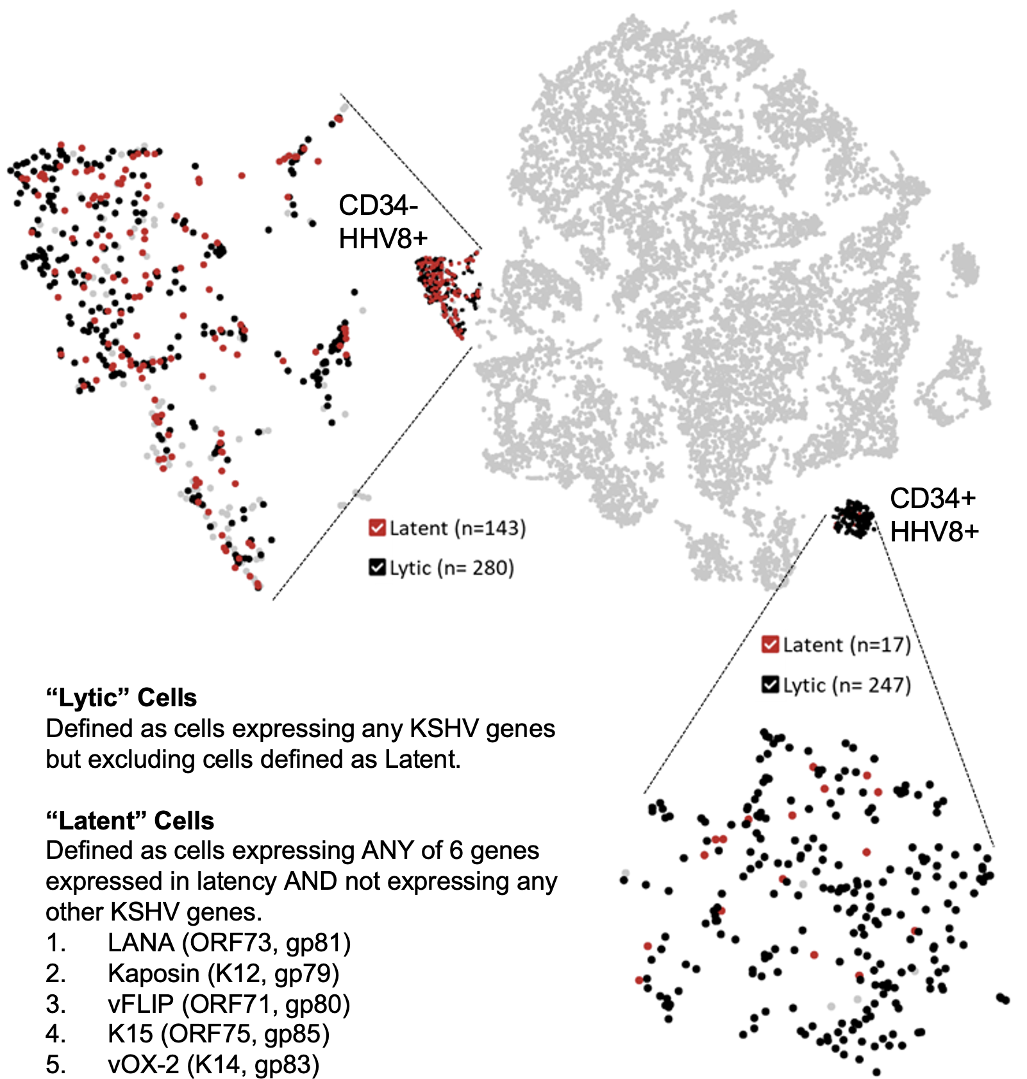
Custom Genomes w/ cellranger mkref
https://support.10xgenomics.com/single-cell-gene-expression/software/pipelines/latest/advanced/references
10X Provides Prebuilt references for:
Human (hg19 and GRCh38)
Mouse (mm9 and mm10)
Why do I need a new reference genome?
Expanded annotations (eg. GENCODE, ncRNAs, etc.)
Additional species (eg. Maize)
Monitoring custom transgenes
Viruses, pathogens
Known rearrangements, model specific genomes
Unconventional gene annotations
What do I need?:
Genome FASTA file
GTF file containing feature coordinates
Lee Ratner & Daniel Rauch

Slide 7
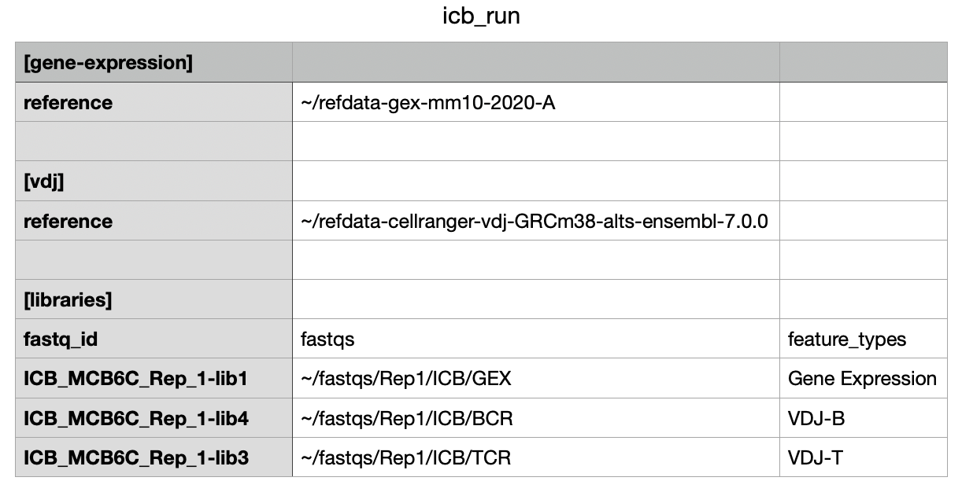
Running cellranger multi (v7.0.0)
SAMPLE=Rep1_ICB
cellranger multi \
--localmem 64 \
--localcores 4 \
--id Rep1_ICB \
--csv ICB_run.csv

Slide 8
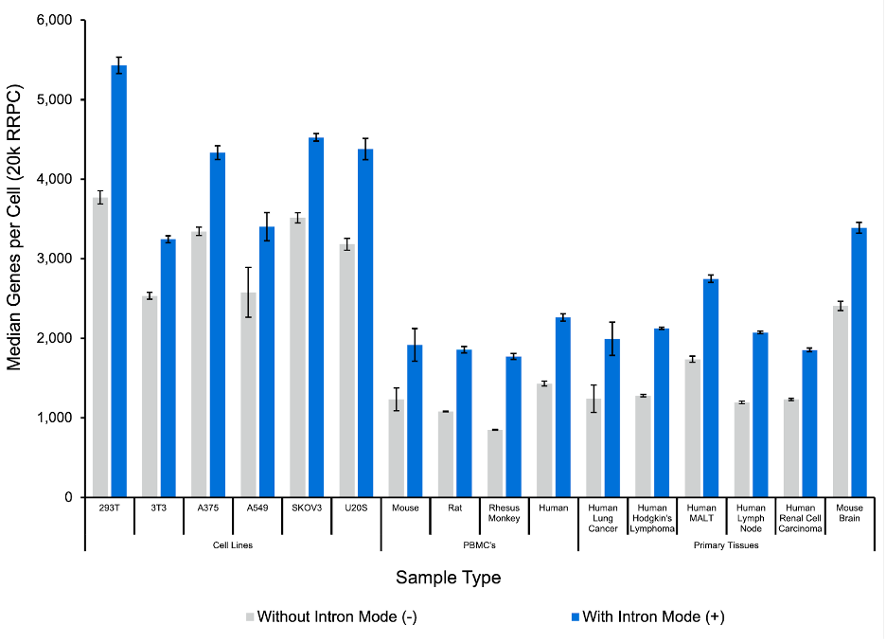
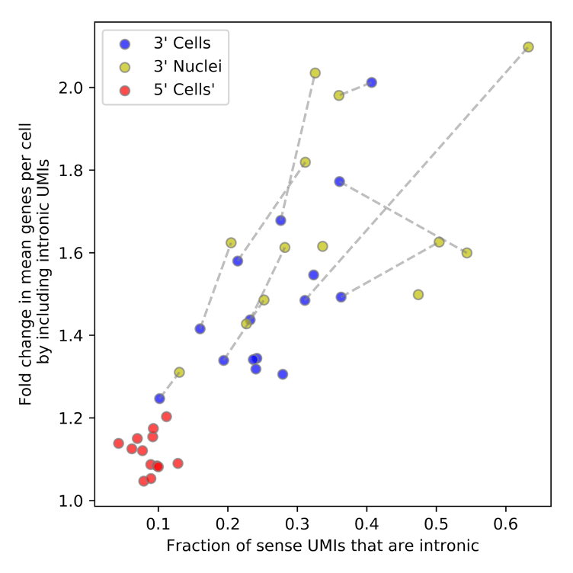
--include-introns …?
Should intronic reads be counted toward UMI counts?
Single nucleus RNAseq:
YES (duh).
Single cell RNAseq:
Debatable.
More UMIs, but less comparable to legacy datasets
Default Behavior:
Pre-Cell Ranger 7:
--include-introns=False
Cell Ranger 7+
--include-introns=True
https://kb.10xgenomics.com/hc/en-us/articles/4998628924429-Why-should-I-include-introns-for-my-single-cell-whole-transcriptome-Gene-Expression-data-analysis-

Slide 9
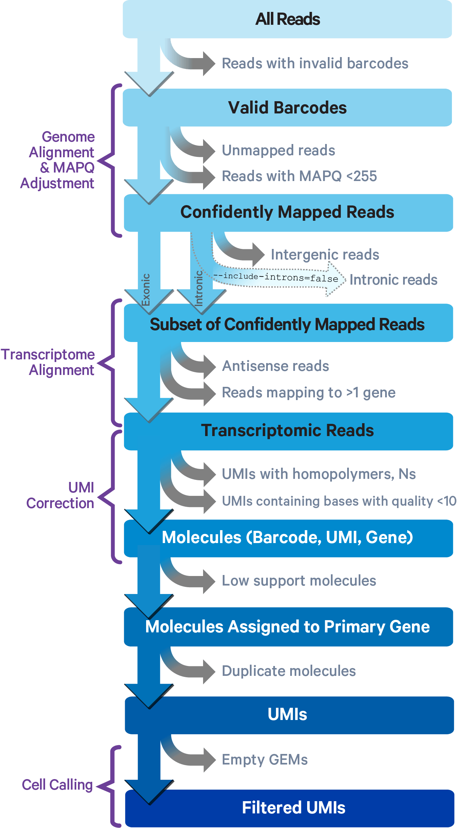
Overview of cellranger count
“Secondary Analysis”
Dimensionality reduction, clustering, etc

Slide 10
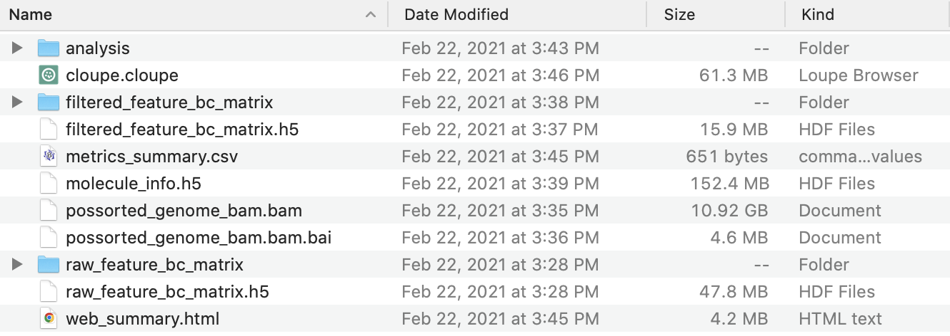
Cell Ranger Pipeline Output
Highly
Processed
Raw
FASTQ
/seq/Illumina_runs/NextSeqData/NextSeqOutput/181221_NB551387_0127_AHHL52BGX9/HHL52BGX9/outs/fastq_path
Note: 10X has a bamtofastq tool that can reconstruct a publishable, lossless FASTQ directly from the mapping output bam file

Slide 11
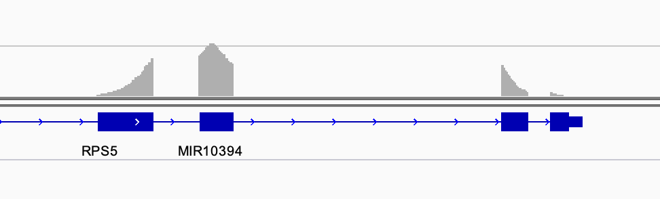
BAM file You should Archive this!
(base) [jpreall@bamdev2 outs]$ samtools view possorted_genome_bam.bam | head -n 1
NB501555:883:HKHCNBGXH:1:13203:17140:14586 16 1 3000079 255 56M * 0 0 AAACCATTTGGTCCCTTTCTTTTTTTTTTTTTTTTTTTTTTTTTTGGGTGGGAGAC EE//A//////////////6EEEEEEEEEEEEEEEEEEEEEEEEEEEEEEEAAAAA NH:i:1 HI:i:1 AS:i:43 nM:i:6 RG:Z:Vakoc_YH02_trachea:0:1:HKHCNBGXH:1 RE:A:I xf:i:0 CR:Z:AGCTTCCTCTTCCCGA CY:Z:AAAAAEEEEEEEEEEE CB:Z:AGCTTCCTCTTCCCGA-1 UR:Z:AGTTATTCCCAA UY:Z:EEEEEEEEEEEE UB:Z:AGTTATTCCCAA
Stores alignment features, cell barcode, overlapping genes, UMI
Contains complete record of sequencing data
FASTQs can be faithfully recreated (eg. for publication) using bam2fastq
Can be viewed as a browser track
Can be be used to extract per-cell genotype / allelic expression using Vartrix

Slide 12
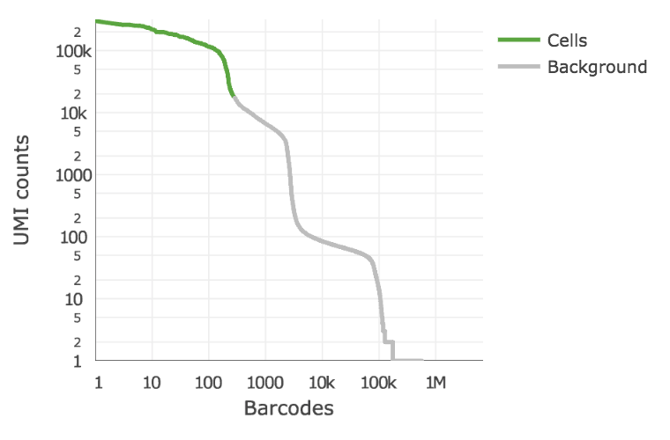
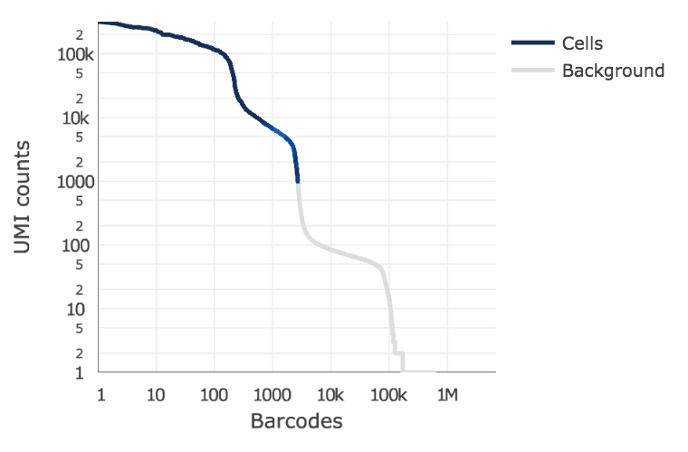
Cell Ranger: Cell Calling Algorithm
Based on EmptyDrops
https://genomebiology.biomedcentral.com/articles/10.1186/s13059-019-1662-y
Low-UMI cells
(eg. T-cells)
Likely
empty
Cellranger 2
Cellranger 3+
Inflection point of knee plot
Missed Low-UMI cell types
Compares each barcode with likely empty droplets
Much more permissive – keeps dead cells any anything remotely “cellish”

Slide 13
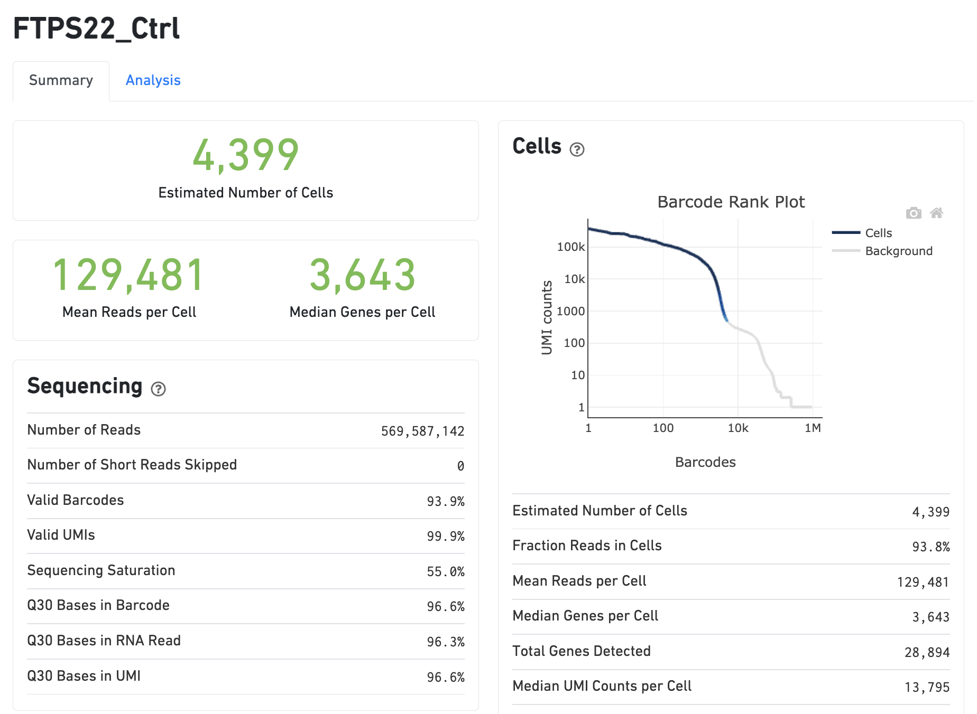
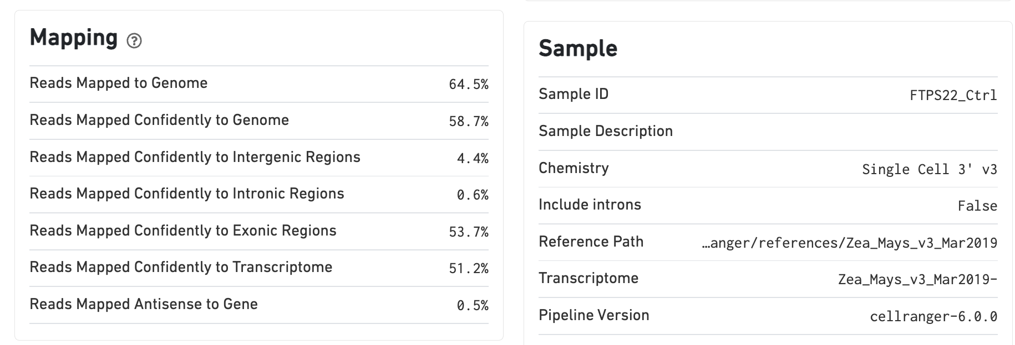
Quality Control: web_summary

Slide 14
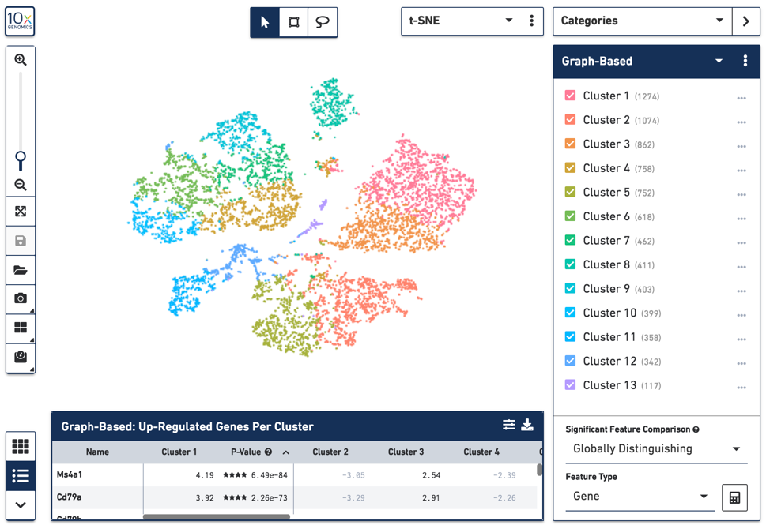
Loupe Browser
Can:
Quickly visualize genes
Do guided clustering via marker genes / tSNE selections
Calculate Differential Expression
Export cells and gene sets for reanalysis on Cellranger (cluster)
Can’t
Compute & track composite features (eg. %mito, cell cycle)
Perform linear regression
Filter Doublets
Properly batch correct
Pseudotime, other fancy things
Tutorial:
https://support.10xgenomics.com/single-cell-gene-expression/software/visualization/latest/tutorial

Slide 15
Quality Control: QC metrics – Cell Death
Filter cells by Fraction Mitochondrial Reads
Healthy Cell
1,142 cells
Fraction Mitochondrial
mRNA
Mitochondrion
20,283 cells
Dying / Ruptured Cell

Slide 16
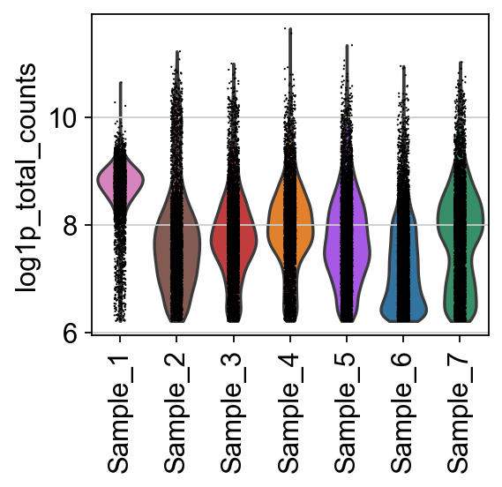
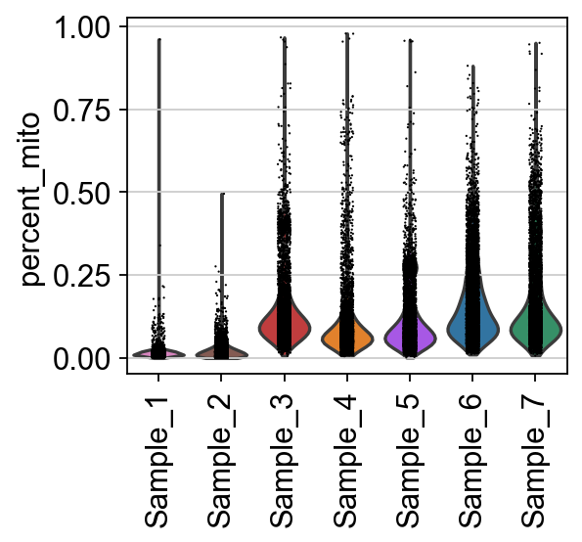
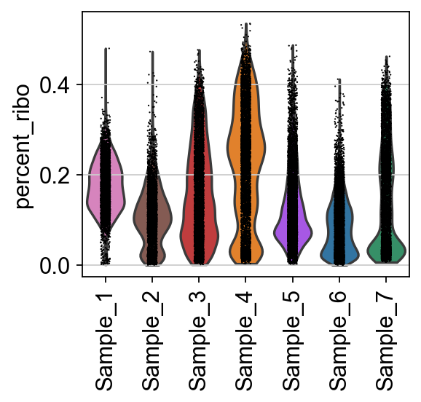
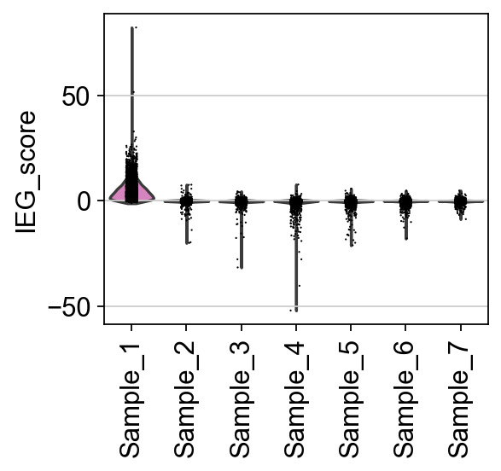
Quality Control: QC metrics -> interpret cautiously
UMI counts:
Cell types
Viability
Sequencing depth
Library handling
Mitochondrial %
Dying cells
Respiration activity!
(some cells have > 50% but are alive!)
Immediate-Early Genes
Post-dissoc. stress
In vivo acute activation
Ribosomal %
Cell types
Activation / Metabolism
Sequencing depth
(normalization artifact)

Slide 17
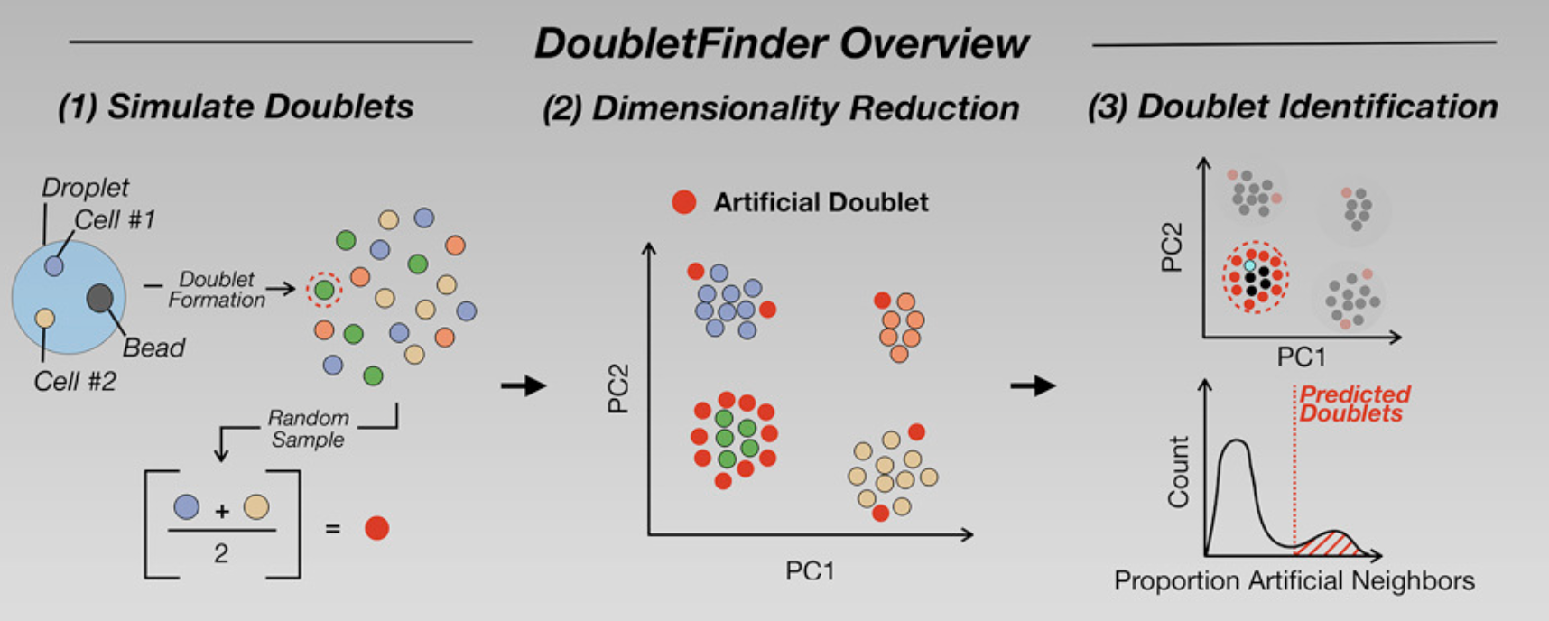
Quality Control: Doublet Filtering
DoubletFinder
DoubletFinder - [R] - Doublet detection in single-cell RNA sequencing data using artificial nearest neighbors. BioRxiv
Doublet Finder – simplified explanation:
Relies solely on gene expression data
Begins by simulating artificial doublets and incorporating these “cells” into existing scRNA-seq data processed with “Seurat”
Then distinguishes real doublets from singlets by identifying real cells with high proportions of artificial neighbors in gene expression space.
In other words, real cells that have a similar expression patterns to the simulated doublets and cluster together with them
Other methods:
DoubletDecon , DoubletDetection , Scrublet

Slide 18

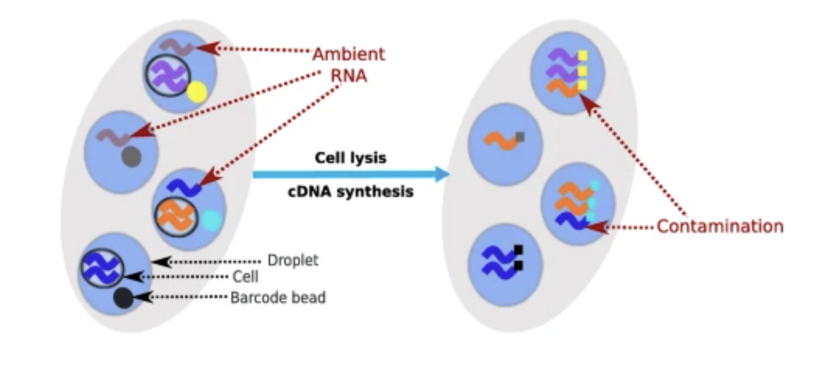
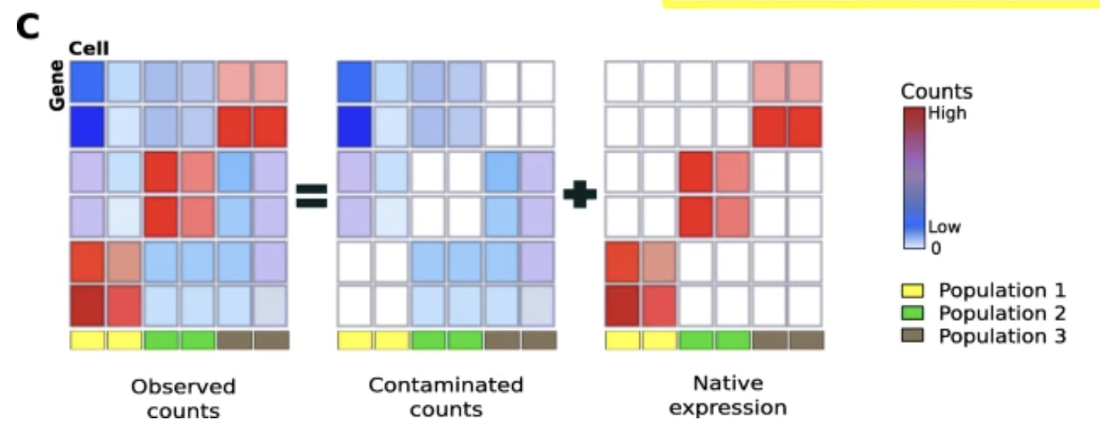
Quality Control: Ambient RNA (soup)
Models “soup” as a weighted combination of other cell types in the population
DecontX assumes that each cell is a mixture of two distributions: (1) a distribution of native transcripts from the cell’s true population and (2) a distribution of contaminating transcripts from all other cell populations captured in the assay.
Produces a matrix of contamination counts and a matrix of “native” counts which can be used in downstream analyses

Slide 19


Secondary Analysis
R
Rahul Satija – NYGC / NYU
Python
Fabian Theis - München

Slide 20
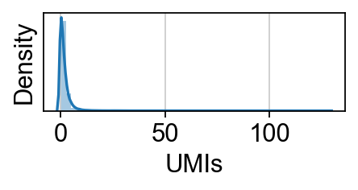
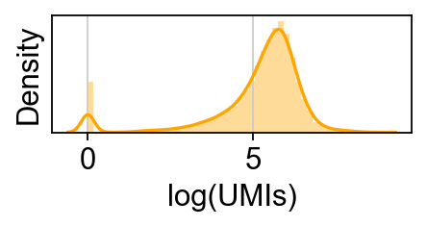
Normalization & log transformation
Basic Method:
Gene(i)Counts
All Gene Counts
* 10,000 (ie. transcripts per 10k, “tp10k”)
Alternatively, though less commonly:
* 1e6 (ie. transcripts per million, “tpm”)
Does not account for stochastic variation in droplet performance, batch, other noise
OR innate difference in UMI counts between cell types!
Add 1
Logarithmize
Basic variance stabilizing transformation

Slide 21
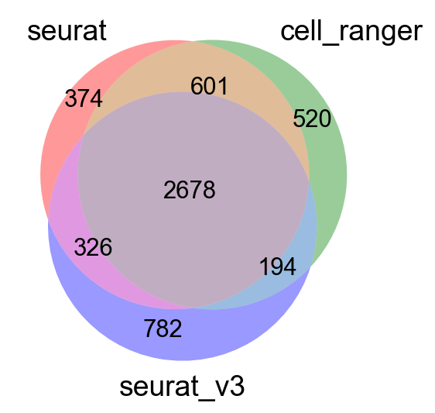
Feature Selection: Highly Variable Genes (HVGs)
Assumption: genes that are interesting in the data will have higher variance
Count-based RNA-seq data has higher variance with higher expression (mean-variance relationship)
Thus, different approaches to select HVGs exist to select relevant HVGs to account for their expression ‘bin’

Slide 22
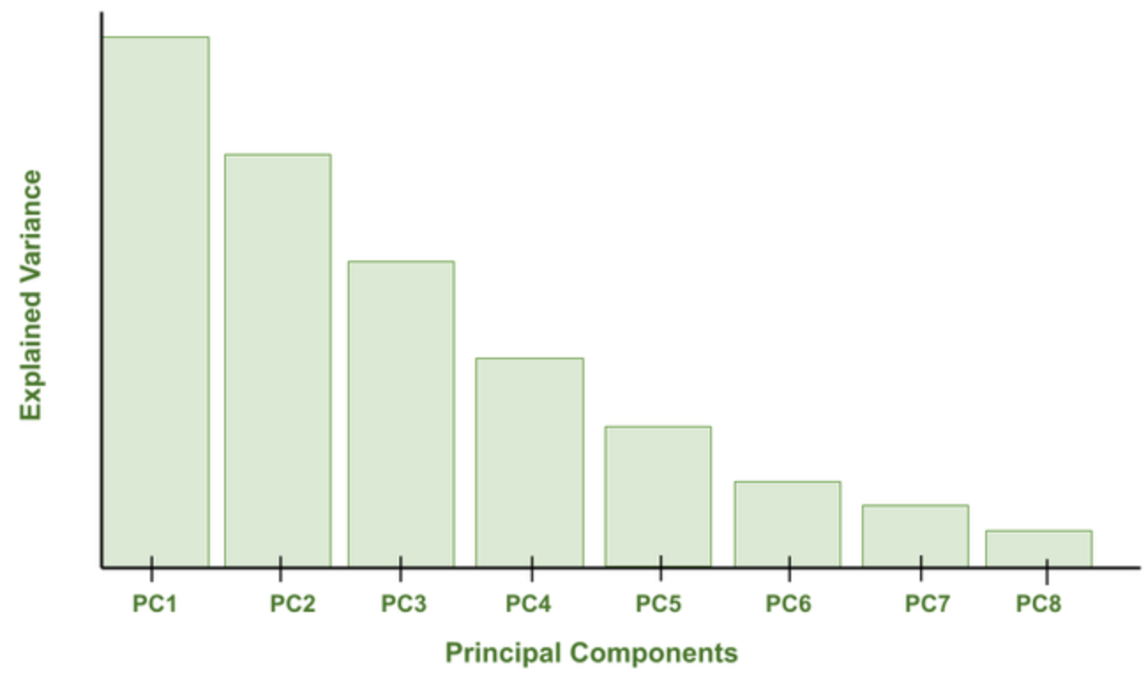
Principal Component Analysis
“Principal component analysis, or PCA, is a dimensionality reduction method that is often used to reduce the dimensionality of large data sets, by transforming a large set of variables into a smaller one that still contains most of the information in the large set.”
https://builtin.com/data-science/step-step-explanation-principal-component-analysis
Explanation of theory of PCA:
https://hbctraining.github.io/scRNA-seq_online/lessons/05_theory_of_PCA.html

Slide 23
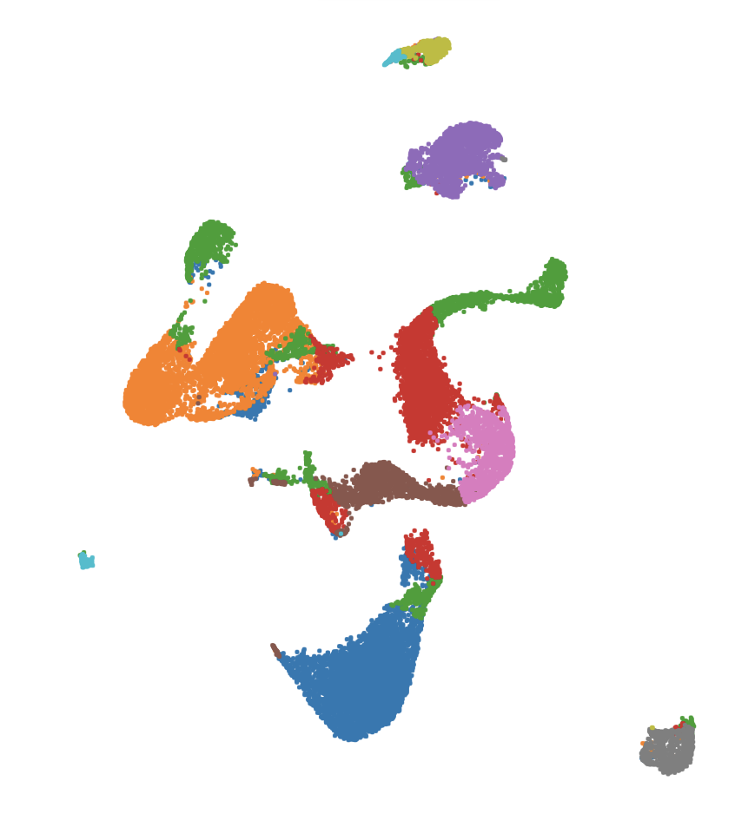
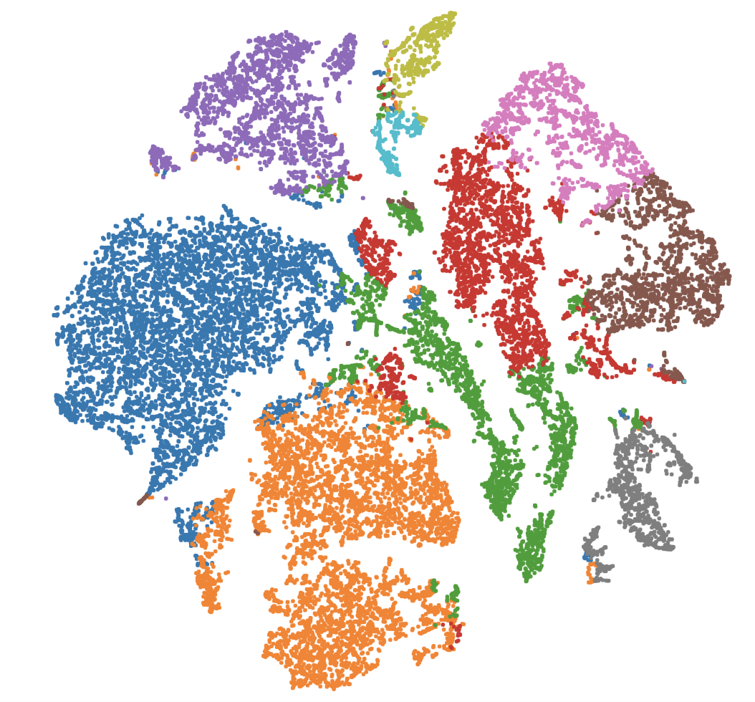
Visualization with tSNE/UMAP
T-distributed stochastic neighbor embedding
Uniform Manifold Approximation
Non-linear dimensionality reduction best suited to visualization
PCA space → Neighbor Graph →
Not a good way to cluster cells
But clusters should correlate visually
Very Similar Algorithms
tSNE runs a normalization on
distance graph in PCA space, UMAP doesn’t
tSNE favors fine / local structure
UMAP “smooths” clusters, favors global structure
Speed: UMAP >> tSNE
Proximity roughly corresponds to similarity
tSNE
UMAP

Slide 24
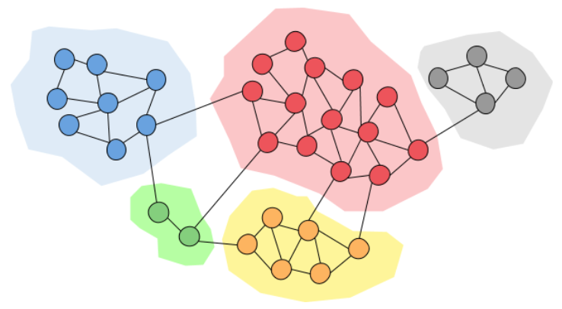
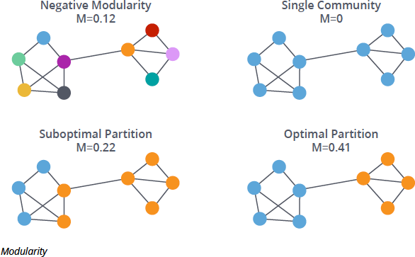
Clustering
Generally, run on latent space (e.g., PC space)
Built into Cell Ranger, most 3rd party tools:
K-means:
Ask algorithm to break data into ‘K’ optimally distinct clusters
Usually run iteratively over a range of ‘K’ based on expectations of cell types, state, etc. in data
Graph-Based (e.g., Louvain or Leiden Modularity Optimization)
Compute all pairwise Euclidean distances in latent space
Trim graph only keep each cells ‘K’ nearest neighbors* (k
“kNN Graph”
Draw boundaries around “communities” of connected cells to optimize modularity (in-group connections vs out-group connections)
*(Completely unrelated to K in K-means!)

Slide 25
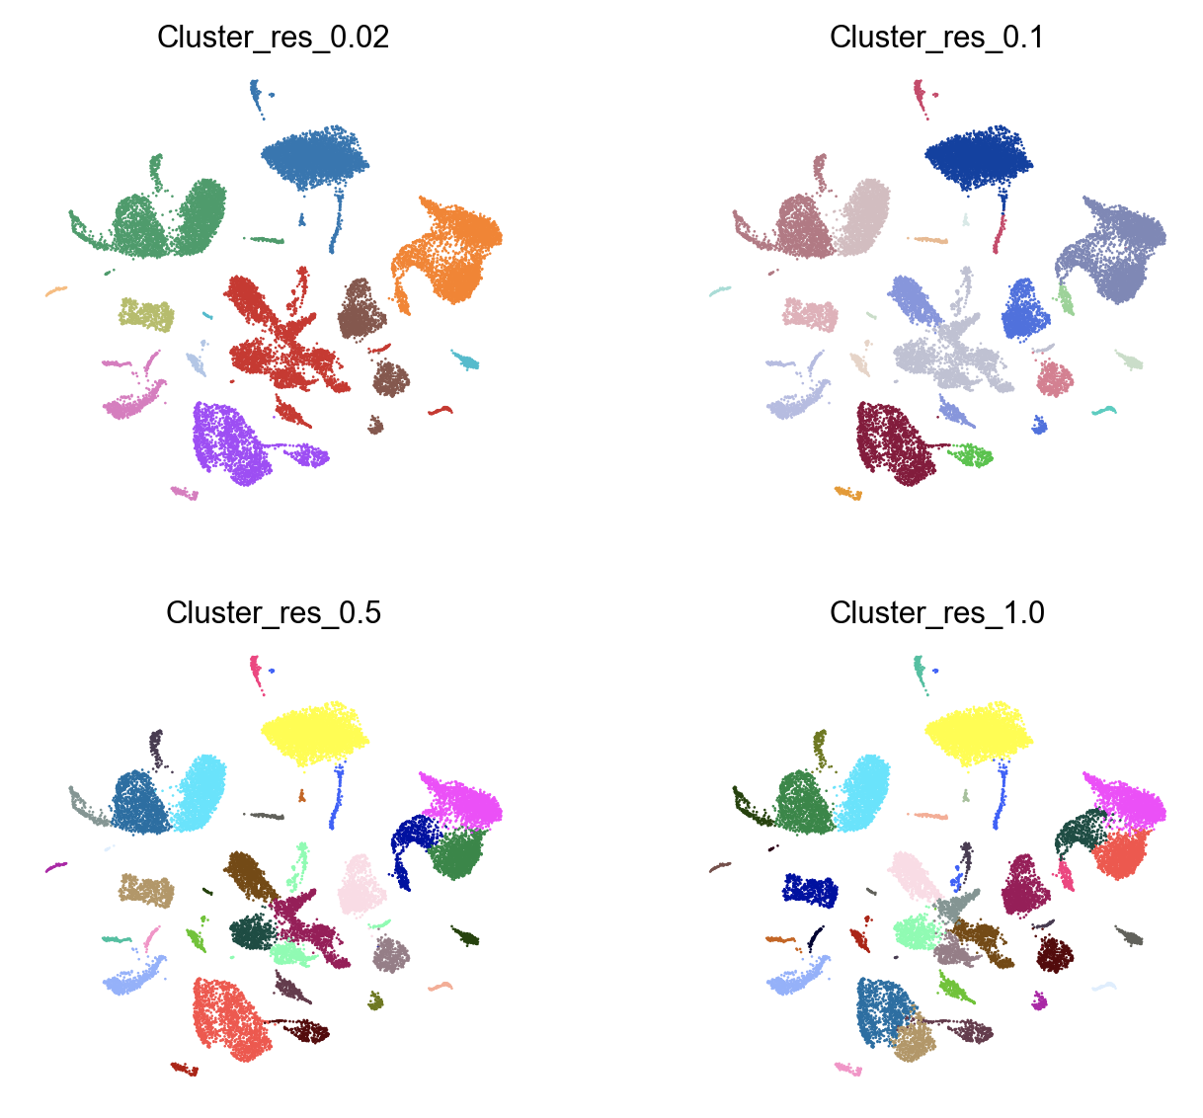
Clustering Resolution
Resolution parameter tunes clustering sensitivity
Optimal clustering is subjective
Guided sub-clustering may provide best result s
i.e., globally changing resolution parameter may nicely identify meaningful subtypes of one kind of cell, while breaking others into meaningless arbitrary blobs.
Note: Clustering is probabilistic: reproducibility requires manually setting a random seed!
High resolution
Too Low: miss subtypes, phenotypic states
Too High: over-clustered, no meaningful distinguishing marker genes

Slide 26
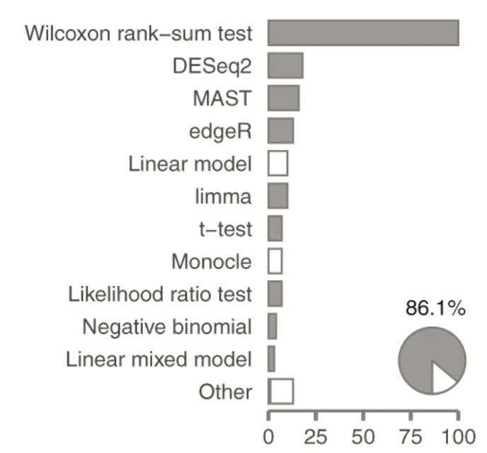
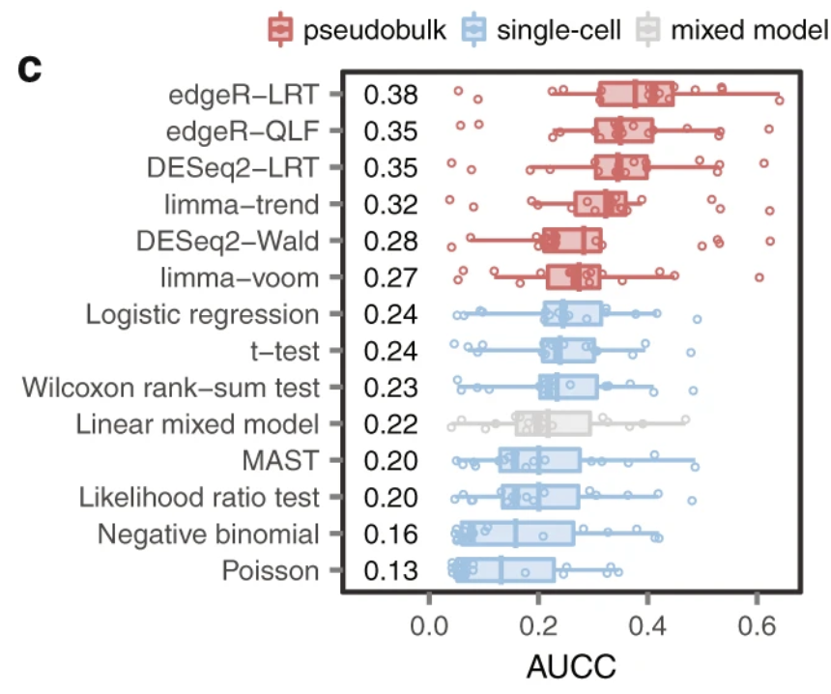
Differential Gene Expression
Popularity
Performance vs ‘Ground Truth’ datasets
Seurat:
Default: Wilcoxon
Many other tests built in
Scanpy:
Default: t-test
use scDE or other plugins for additional tests
Cell Ranger:
Defaults: Exact Negative Binomial (low cell counts)
EdgeR NB (high cell counts)
Squair, J.W., Gautier, M., Kathe, C. et al. Confronting false discoveries in single-cell differential expression. Nat Commun 12, 5692 (2021). https://doi.org/10.1038/s41467-021-25960-2
Single-cell methods biased towards highly expressed genes
Pseudobulk methods make fewer false discoveries of highly expressed genes
(i.e. bin clusters or similar cells to reduce zeros and control for high variance in highly expressed genes)

Slide 27

Cell Type Identification
Name | Version | Language | Underlying classifier | Prior knowledge | Rejection option | Reference
Garnett | 0.1.4 | R | Generalized linear model | Yes | Yes | [14]
Moana | 0.1.1 | Python | SVM with linear kernel | Yes | No | [15]
DigitalCellSorter | GitHub version: e369a34 | Python | Voting based on cell type markers | Yes | No | [16]
SCINA | 1.1.0 | R | Bimodal distribution fitting for marker genes | Yes | No | [17]
scVI | 0.3.0 | Python | Neural network | No | No | [18]
Cell-BLAST | 0.1.2 | Python | Cell-to-cell similarity | No | Yes | [19]
ACTINN | GitHub version: 563bcc1 | Python | Neural network | No | No | [20]
LAmbDA | GitHub version: 3891d72 | Python | Random forest | No | No | [21]
scmapcluster | 1.5.1 | R | Nearest median classifier | No | Yes | [22]
scmapcell | 1.5.1 | R | kNN | No | Yes | [22]
scPred | 0.0.0.9000 | R | SVM with radial kernel | No | Yes | [23]
CHETAH | 0.99.5 | R | Correlation to training set | No | Yes | [24]
CaSTLe | GitHub version: 258b278 | R | Random forest | No | No | [25]
SingleR | 0.2.2 | R | Correlation to training set | No | No | [26]
scID | 0.0.0.9000 | R | LDA | No | Yes | [27]
singleCellNet | 0.1.0 | R | Random forest | No | No | [28]
LDA | 0.19.2 | Python | LDA | No | No | [29]
NMC | 0.19.2 | Python | NMC | No | No | [29]
RF | 0.19.2 | Python | RF (50 trees) | No | No | [29]
SVM | 0.19.2 | Python | SVM (linear kernel) | No | No | [29]
SVM_{rejection} | 0.19.2 | Python | SVM (linear kernel) | No | Yes | [29]
kNN | 0.19.2 | Python | kNN (k = 9) | No | No | [29]
A hard problem
What even is a cell type?
Who is curating these?
Cell types versus states
normal vs disease / perturbed
What type of model is being used?
Marker-based
Reference dataset label transfer
https://www.scrna-tools.org/tools?sort=name&cats=Classification
MANY more tools available
Abdelaal, T., Michielsen, L., Cats, D. et al. A comparison of automatic cell identification methods for single-cell RNA sequencing data. Genome Biol 20, 194 (2019). https://doi.org/10.1186/s13059-019-1795-z

Slide 28
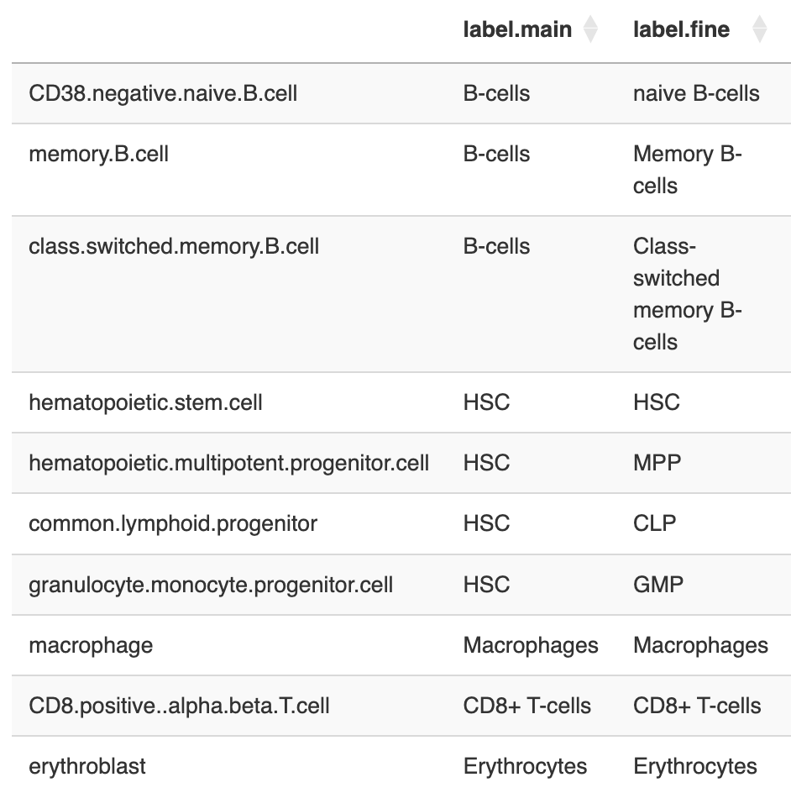
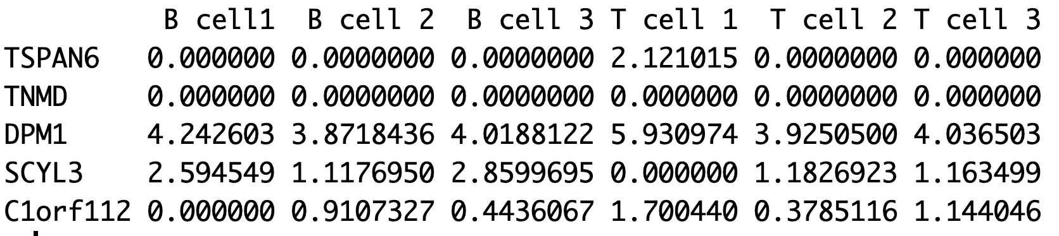
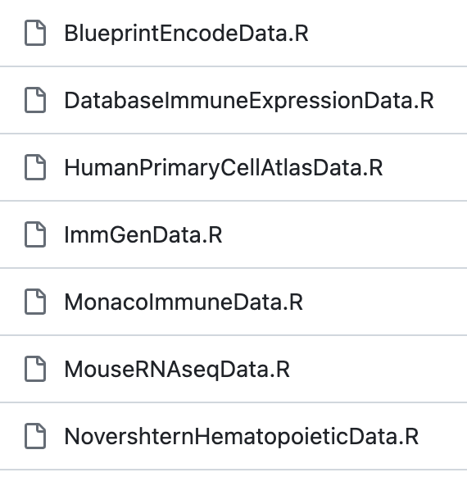
Celldex - reference index for cell types
https://github.com/LTLA/celldex

Slide 29
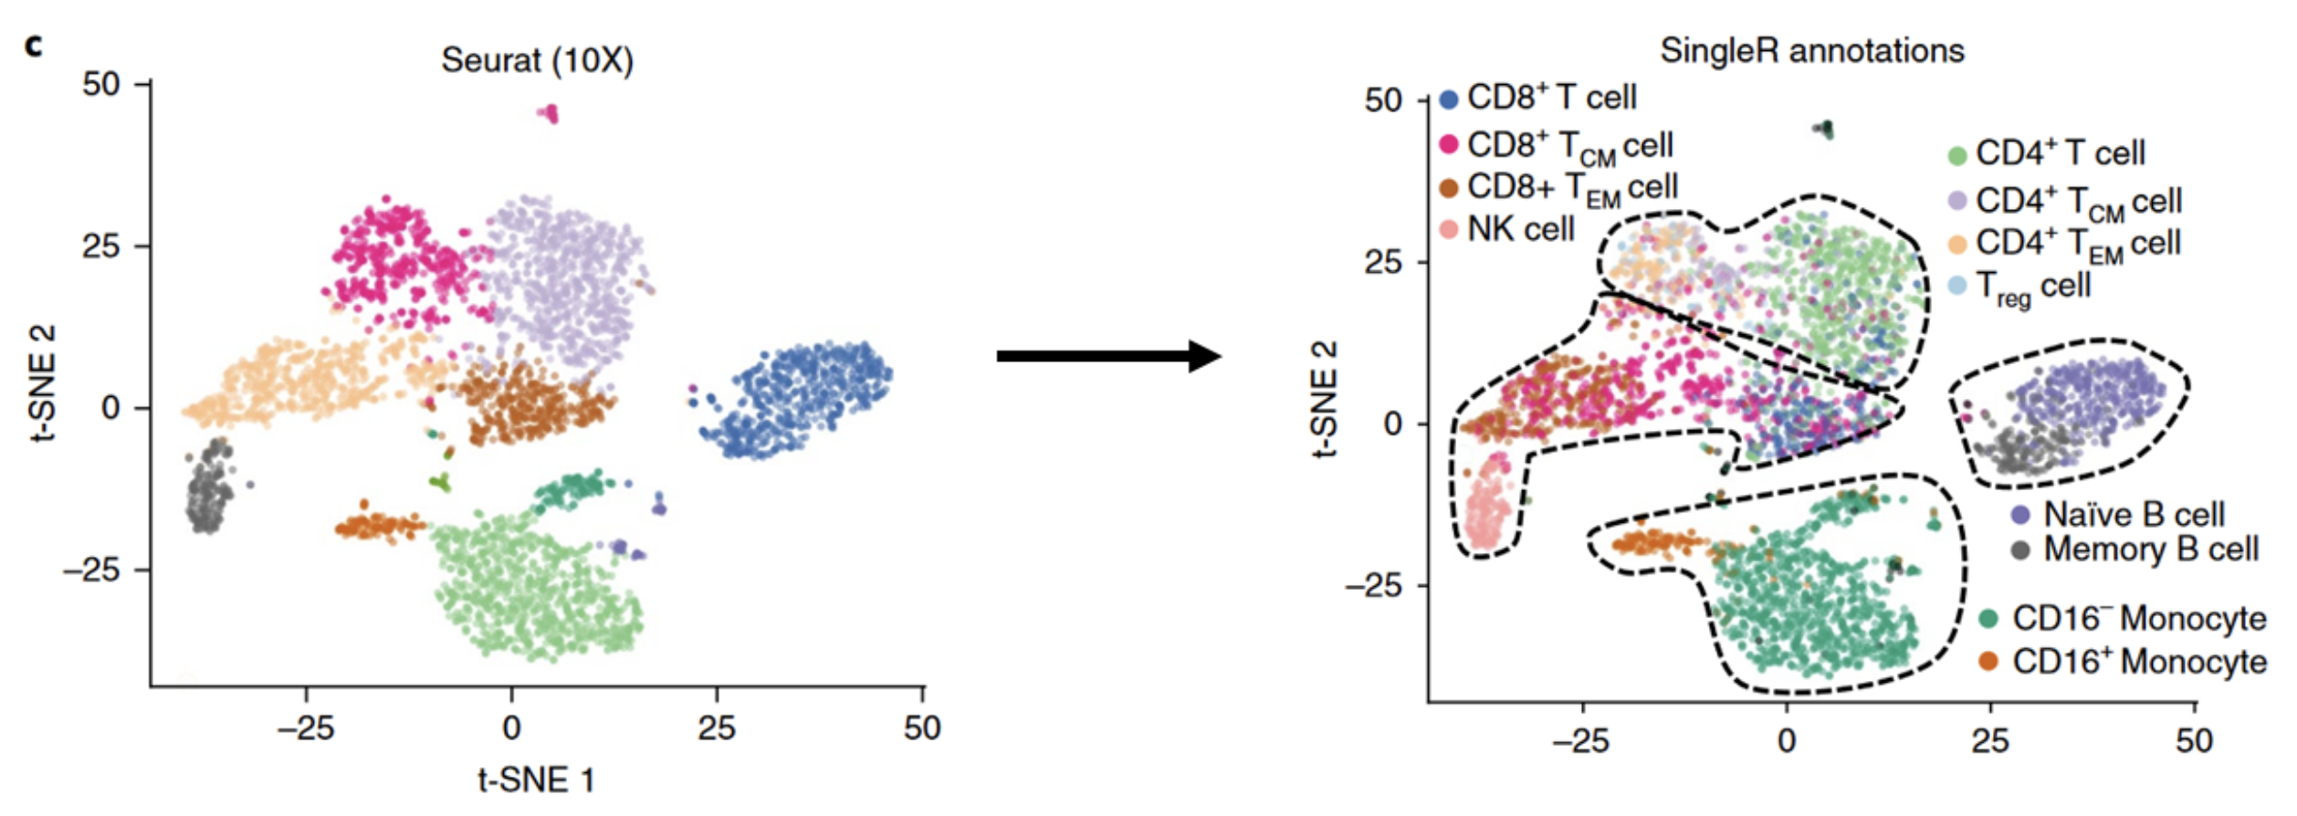
singleR - reference-based single-cell RNA-seq annotation
https://biostatsquid.com/singler-tutorial/

Slide 30

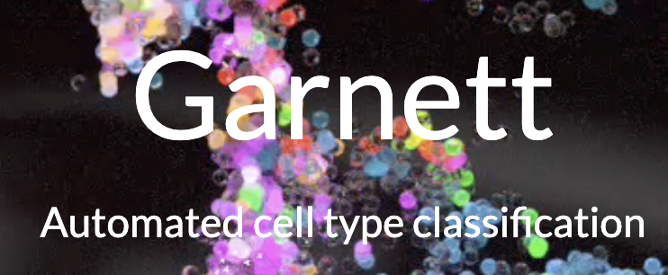
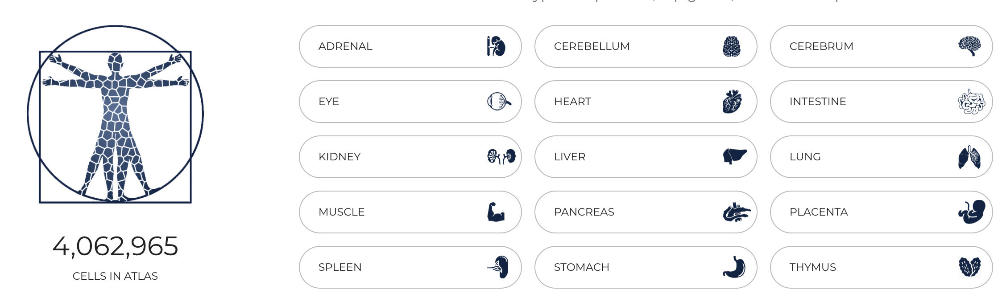

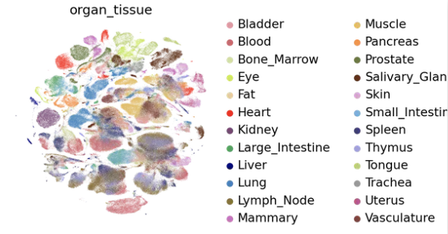

Atlas Efforts building Cell Type Classifiers

Slide 31
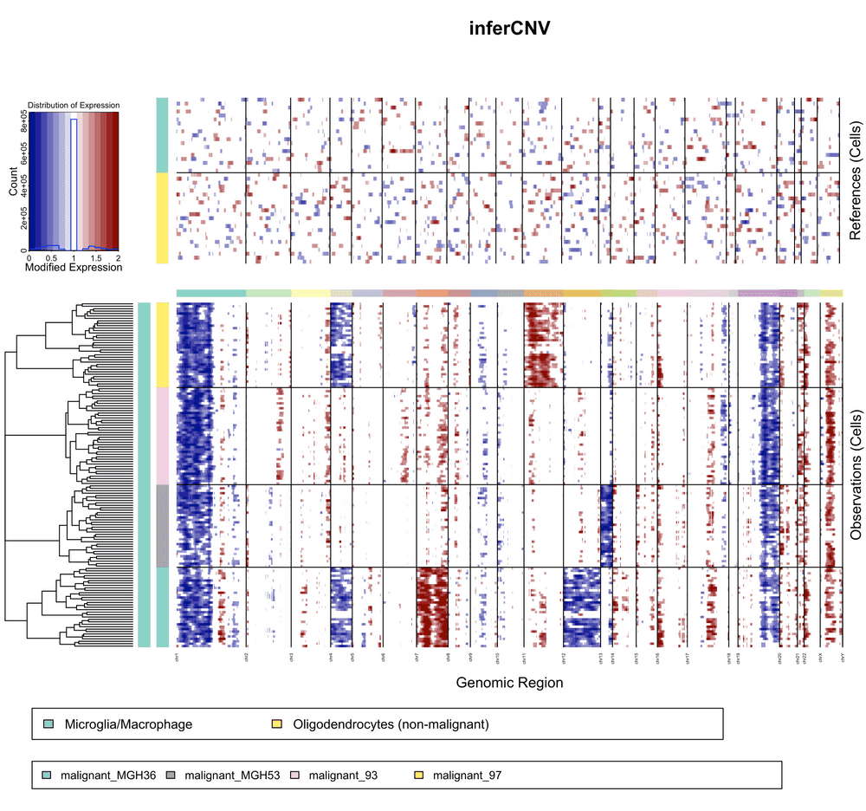
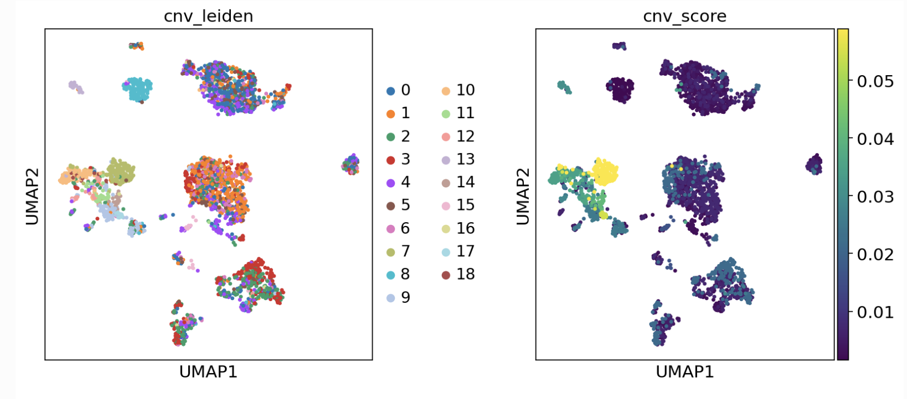
CNV inference
”Normal”
Reference cells
Eg. inferCNV, CaSpER, CopyKAT, SCYN, CONICS
Query Cells
Eg. Polyclonal
Cancer
Counts binned expression data across chromosomes
Build a background model based on provided “Normal” reference
Identifies regions with higher-than-expected expression across entire window
Low resolution (multi-megabase) for scRNAseq
Can still resolve large-scale clonal copy number loss / gain in chromosome arms, etc.

Slide 32
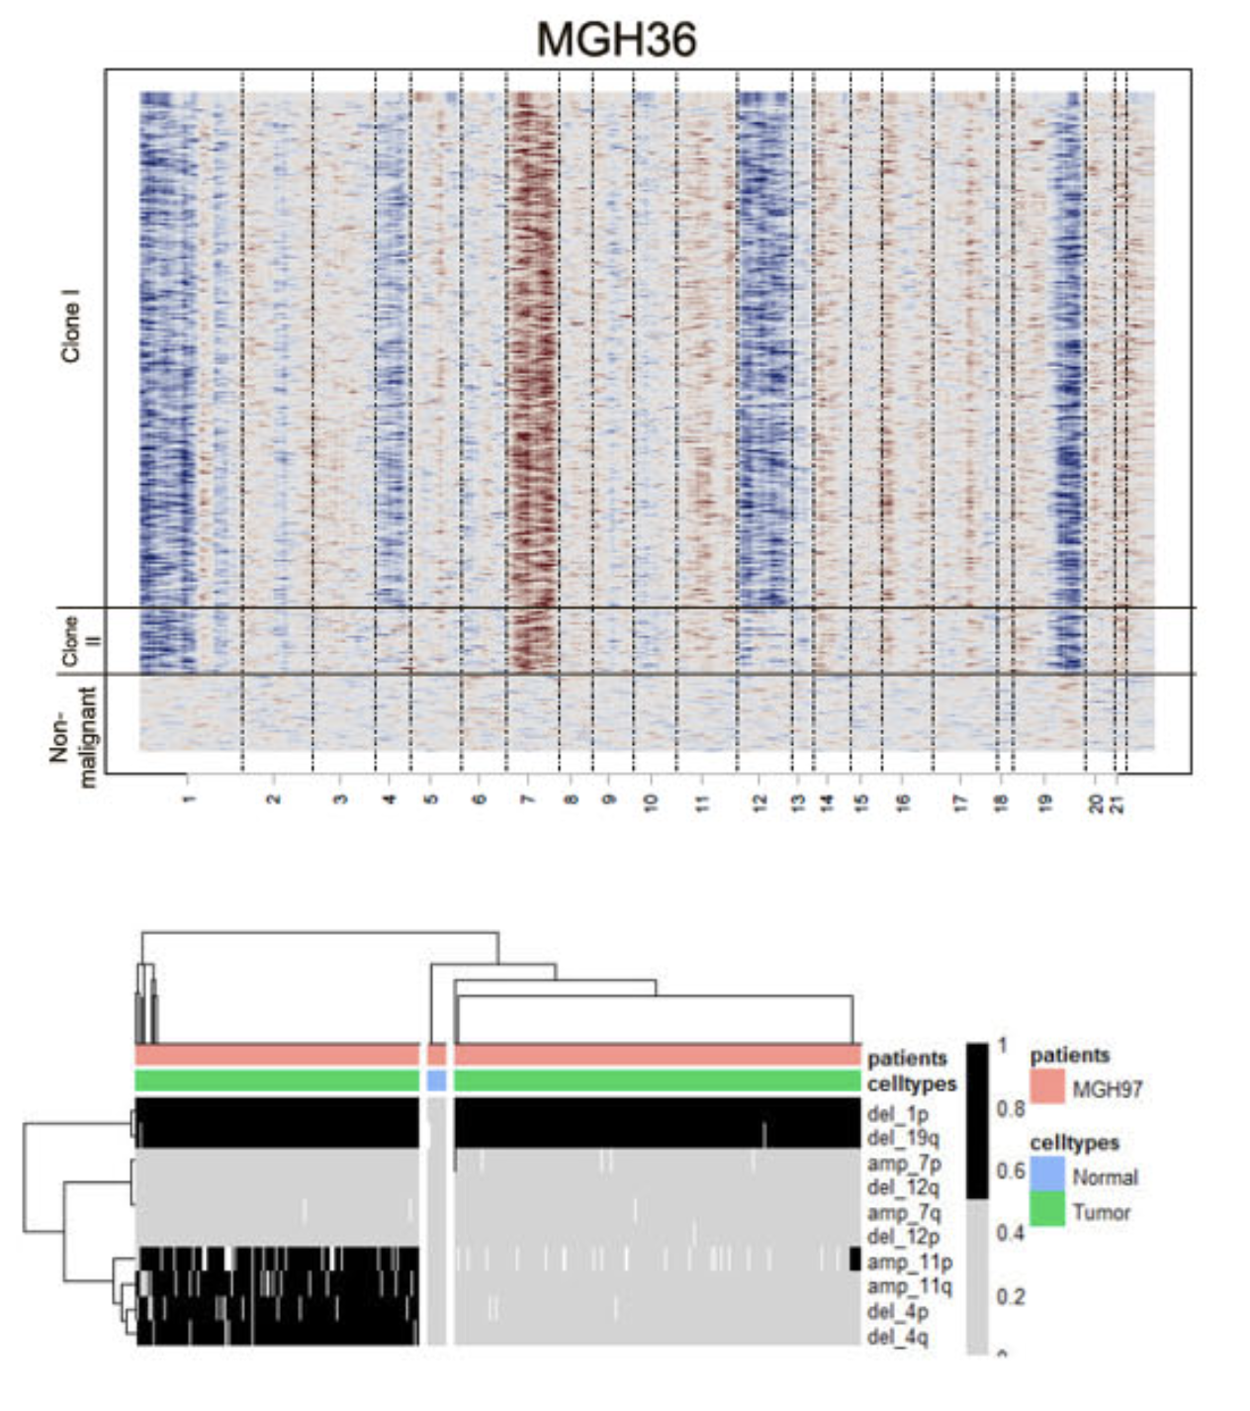
CONICS: COpy-Number analysis In single-Cell RNA-Sequencing
Single cells
Single cells

Slide 33
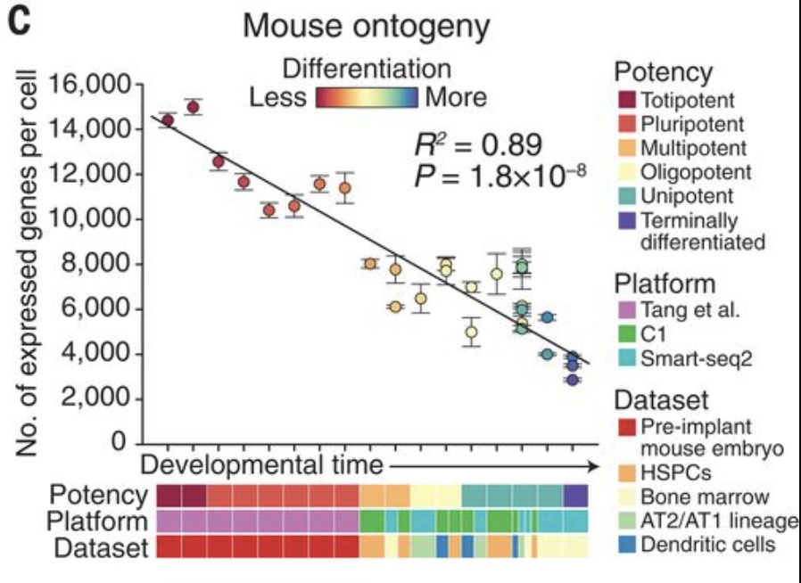


Cytotrace - Trajectory Reconstruction Analysis using gene Counts and Expression
Based on a simple idea that actually seems to work.
As cells become more differentiated, they express fewer genes
https://doi.org/10.1126/science.aax0249

Slide 34



VarTrix – single cell genotyping tool

Slide 35



Transcriptional Dynamics: RNA Velocity
Estimates rates of change in mRNA levels by modeling nascent RNA synthesis
Quantifies spliced / unspliced
Models dynamics
CAVEATS: Gene annotations
Cryptic exons
unannotated intronic genes
repetitive elements
Le Manno et al. (2018) Nature

Slide 36


Cultured Cells – RNA Velocity
Siha (cervical epithelium cells)
Projected on to subspace using only cell-cycle relevant genes
RNA Velocity is relevant over very short time scales, when transition states are abundant in the population
S
G1
G2M
Latent time →

Slide 37
So many tools … others not covered yet …
Monocle
Enrichr
scRepertoire
Cell – cell communication
Alternative splicing
Variant discovery
eQTL analysis

